Slide 1
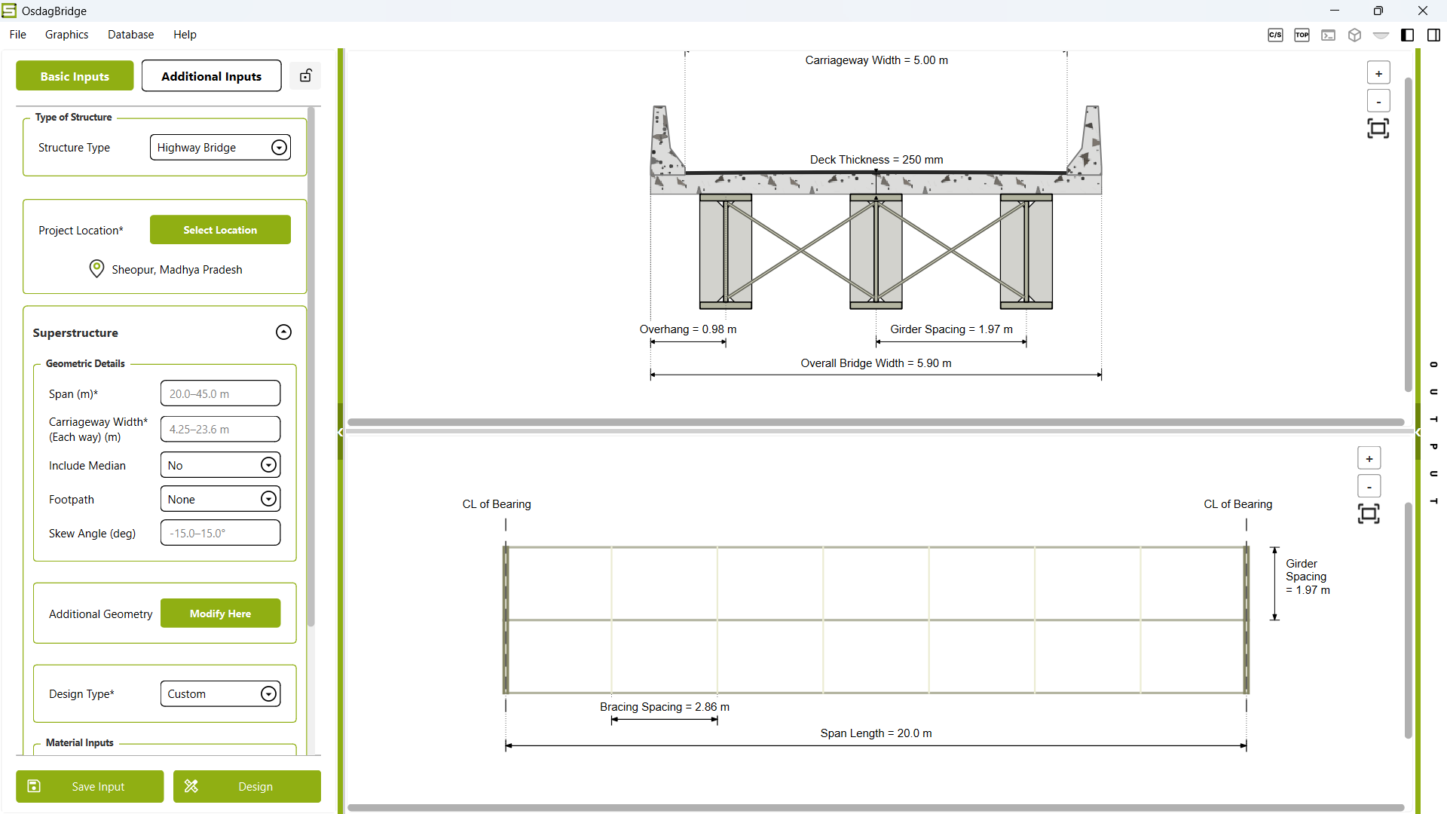
Enter Additional Inputs
Enter Basic Inputs
Select Location
Zoom In
Zoom Out
Fit/Reset View

